Slide 1
Frederick Douglass HS
Notes:
budget.

Slide 2
Norms
This is a meeting of the GO Team. Only members of the team may participate in the discussion. Any members of the public present are here to quietly observe.
We will follow the agenda as noticed to the public and stay on task.
We invite and welcome contributions of every member and listen to each other.
We will respect all ideas and assume good intentions.

Slide 3
GO Team Budget Development Process
YOUR SCHOOL STRATEGIC PLAN…
is your roadmap and your role.
It is your direction, your priorities, your vision, your present, your future.
Step 1: Data Review
Step 2: Strategic Plan Review
Step 3: Budget Parameters
(Strategic Priorities)
Step 4: Budget Choices
Notes:
Today I will provide an overview of the budget allocations for FY23. We will begin the work of funding the strategic priorities we agreed upon during our strategic review meeting. (IF YOU HAVE NOT DECIDED ON YOUR PRIORITIES, YOU WILL SAY – WE WILL DECIDE ON OUR PRIORITIES AND THEN DISCUSS ALLOCATING FUNDS TO ADDRESS THOSE PRIORITIES).

Slide 4
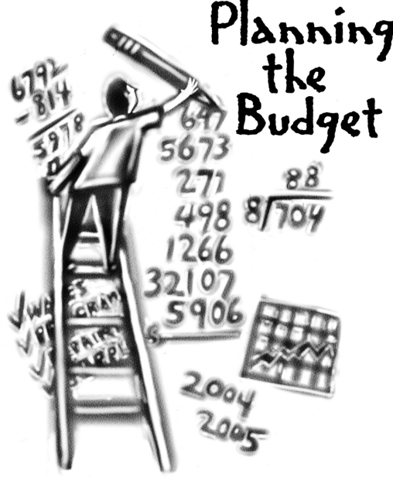
Overview of FY ‘24 GO Team Budget Process
Step 1 Review and Update Strategic Plan and Rank Strategic Priorities
By end of Fall Semester
Step 6 Principals: HR Staffing Conferences Begin
March 2nd
Step 3 GO Team Initial Budget Session: Allocation
January 24 – early February
Step 7 GO Team Final Budget Approval Meeting
Budgets Approved by March 17
Step 5
GO Team Feedback Session: Draft Budget Presented & Discussed February 16th
Step 4 Principals: Associate Supt. Discussions and Review
February (supports needed, specific challenges, coaching)
Step 2 Principals: Workshop FY 24 Budget
January 24
GO Teams are encouraged to have ongoing conversations

Slide 5
Budget Allocation Meeting
What
The first GO Team meeting is when the principal will provide an overview of the budget allocation for GO Team members and the general public.
Why
This meeting provides an opportunity for the principal and GO Team to ensure alignment on the school’s key strategic priorities, gain a deeper understanding of the budget allocation, and provide input to drive the direction of the draft budget.
When
End of January- Early February

Slide 6
FY24 Budget Development Process
Principal’s Role
Design the budget and propose operational changes that can raise student achievement
Flesh out strategies, implement and manage them at the school level
Focus on the day-to-day operations
Serve as the expert on the school
Hire quality instructional and support personnel
The GO Team’s Role
Focus on the big picture (positions and resources, not people)
Ensure that the budget is aligned to the school’s mission and vision and that resources are allocated to support key strategic priorities

Slide 7
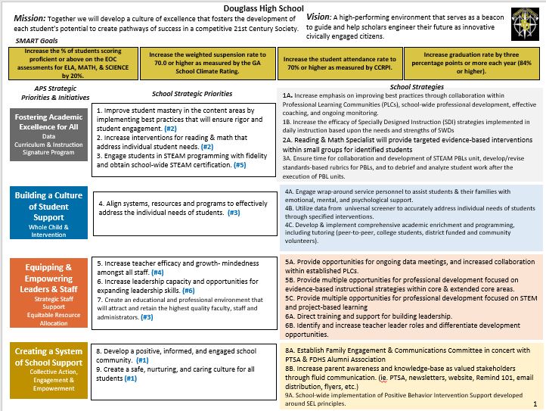
(FDHS Strategic Plan

Slide 8
FDHS
Strategic Plan
Priority Ranking
9. Create a safe, nurturing, and caring culture for all students (#1)
8. Develop a positive, informed, and engaged school community. (#1)
1. Improve student mastery in the content areas by implementing best practices that will ensure rigor and student engagement. (#2)
2. Increase interventions for reading & math that address individual student needs. (#2)
7. Create an educational and professional environment that will attract and retain the highest quality faculty, staff and administrators. (#3)
5. Increase teacher efficacy and growth- mindedness amongst all staff. (#4)
3. Engage students in STEAM programming with fidelity and obtain school-wide STEAM certification. (#5)
6. Increase leadership capacity and opportunities for expanding leadership skills. (#6)
Higher
Lower

Slide 9
Discussion of Budget Summary
(Step 4: Budget Choices)

Slide 10
Executive Summary
This budget represents an investment plan for our school’s students, employees and the community as a whole.
The budget recommendations are tied directly to the school’s strategic vision and direction.
The proposed budget for the general operations of the school are reflected at $_15,747,814_____
This investment plan for FY24 accommodates a student population that is projected to be _1209_ students, which is a increase/decrease of __20____ students from FY23.
Notes:
Here’s a few highlights for our budget this year – read executive summary

Slide 11
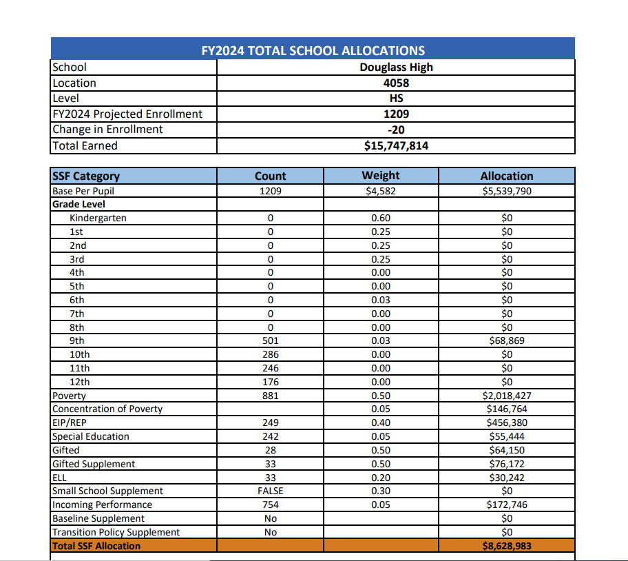
School Allocation
Notes:
For FY23, APS is continuing to increase equity within the District and the flexibility principals have in regards to our schools budgeted funds. The new Student Success Funding Model (SSF) allocates dollars to schools based on the number of enrolled students and receives a funding "weight" based on need. This year, student characteristics were weighted based on:
Grade Level –
K-12
Poverty – Weighted for all Direct Certification enrolled students.
Beginning Performance – Weighted Middle School and High School students entering with beginner’s performance on milestones.
ESOL – Weighted for all ESOL designated students in order to supplement due to ESOL staff being locked.
Special Education - Weighted for all Special Education students.
Gifted – Weighted and measured by number of students in the Gifted Program
Small School Supplement – Weighted for low enrollment schools
ES – 500
MS – 600
HS – 700
As you can see, our projected enrollment for FY23 is _______, we increased/decreased by __________ from last year.
We received the following weights for our student characteristics: (Below is just for the script, principals need to insert their school’s characteristics)
Grade Level
Poverty
Special Education
Gifted
Gifted Supplement
ELL
Small School Supplement

Slide 12
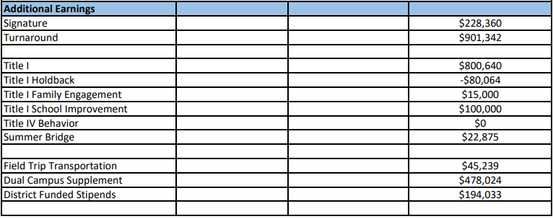
School Allocation
Notes:
For FY23, APS is continuing to increase equity within the District and the flexibility principals have in regards to our schools budgeted funds. The new Student Success Funding Model (SSF) allocates dollars to schools based on the number of enrolled students and receives a funding "weight" based on need. This year, student characteristics were weighted based on:
Grade Level –
K-12
Poverty – Weighted for all Direct Certification enrolled students.
Beginning Performance – Weighted Middle School and High School students entering with beginner’s performance on milestones.
ESOL – Weighted for all ESOL designated students in order to supplement due to ESOL staff being locked.
Special Education - Weighted for all Special Education students.
Gifted – Weighted and measured by number of students in the Gifted Program
Small School Supplement – Weighted for low enrollment schools
ES – 500
MS – 600
HS – 700
As you can see, our projected enrollment for FY23 is _______, we increased/decreased by __________ from last year.
We received the following weights for our student characteristics: (Below is just for the script, principals need to insert their school’s characteristics)
Grade Level
Poverty
Special Education
Gifted
Gifted Supplement
ELL
Small School Supplement

Slide 13
School FY24 CARES Allocation
In addition to a General Fund allocation, our school has been allocated CARES funding that must be used to support implementation of the school-based intervention block and other school-based needs as a result of the COVID-19 Pandemic.
Once the support needed to implement our school-based intervention block/course has been fulfilled, we can use the remaining CARES funds to address other school-based needs that are a result of the COVID-19 Pandemic.
Notes:
Please add your school’s CARES Allocation to this slide.

Slide 14
CARES Allocations Other allowable CARES expenditures include:
Technology Support: Software, assistive technology, online learning platforms, subscriptions.
Mental and Physical Health: Cover the costs of additional counseling, telehealth, therapeutic services, and wraparound services and supports (contracted hours, professional learning, programs)
Supplemental Learning: Cover costs of remediation, and/or enrichment opportunities during the school year for students (afterschool programs, additional pay for teachers and staff, transportation).
Professional Development: Cover costs of additional professional development for school leaders, teachers, and staff (trainings, extended professional development days, consultants, programs).
At-risk Student Populations: Cover costs of school specific activities, services, supports, programs, and/or targeted interventions directly addressing the needs of low-income students, SWD, racial & ethnic minorities, ELL, migrant & homeless students, and students in foster care.
Continuity of Core Staff and Services. Restore any potential LEA FY22 budget reductions due to decreased state and/or local revenue.

Slide 15
What’s Next?
January
GO Team Budget Allocation Meeting (Jan. 26th)
February
One-on-one Associate Superintendent discussions
Cluster Planning Session (positions sharing, cluster alignment, etc.)
Program Manager discussions and approvals
GO Team Feedback Meeting(s) before principal’s staffing conference- February 16th
HR Staffing Conferences (Late February)
March
Final GO Team Approval Meeting – March 2nd (AFTER your school’s Staffing Conference and BEFORE Friday, March 17th)
Notes:
In February, we will meet again to discuss how the school’s budget has been allocated to support the programmatic needs and FY23 key strategic priorities.
If think we need to continue our budget conversations, we will schedule additional meetings. My goal is to make sure your voices are reflected in our school’s budget.
I will also be meeting with my Associate Superintendent, program managers and other key leaders to go over our budget and to make sure the school is meeting the standards of service and appropriately staffing.
During the week of Feb. 24th -March 2nd , HR Staffing Conferences will be held. At this meeting, I will present my plan for staff utilization, resource distribution and plan for staffing implications.
We will need to approve the budget at the ________ meeting.

Slide 16
Questions?
Thank you for your time and attention.

Slide 17
FDHs Budget Feedback Meeting
To be presented to GO Team BEFORE the school staffing conference

Slide 18
Overview of FY ‘24 GO Team Budget Process
Step 1 Review and Update Strategic Plan and Rank Strategic Priorities
By end of Fall Semester
Step 6 Principals: HR Staffing Conferences Begin
Late February – Early March
Step 3 GO Team Initial Budget Session: Allocation
January 24 – early February
Step 7 GO Team Final Budget Approval Meeting
Budgets Approved by March 17
Step 5
GO Team Feedback Session: Draft Budget Presented & Discussed February – multiple meetings, if necessary
Step 4 Principals: Associate Supt. Discussions and Review
February (supports needed, specific challenges, coaching)
Step 2 Principals: Workshop FY 24 Budget
January 24
GO Teams are encouraged to have ongoing conversations

Slide 19
Budget Feedback Meetings
What
The GO Team feedback session(s) should be scheduled for the principal to provide an overview of the school’s draft budget for the GO Team members and the general public.
Why
This meeting provides an opportunity for GO Teams to discuss how the school’s budget has been allocated to support the programmatic needs and key strategic priorities.
When
Meetings must be held in February before staffing conferences. May be combined with the allocation meeting (as needed), if the GO Team has completed strategic plan updates and ranked strategic priorities.
Notes:
Looking for general consensus prior to Staffing Conferences

Slide 20
FY24 Budget Parameters
FY24 School Priorities | Rationale
Maintain lower class sizes in the primary years by funding parapros in 1st and second grade | 47% mobility rate requires a great deal of teacher attention to students who enter our school throughout the year – many of which are below level.
Maximize wrap around services ie: Nurse, SSW, Counseling | This continues to be a need for our students, but we need to look closely at maximizing our budget to make this work.
Increase Reading/Lexiles and writing of 3rd – 5th grade students. How can we restructure our program to achieve this? | Data indicates that students who have been with us for more than one year have greater performance levels than students who are transient. With 47% of our students coming and going, there is a need to target these students.
Example
Notes:
Review the priorities that the GO Team has developed and the rationale for these priorities. Feel free to copy this slide if you have more than 3 priorities to account for.

Slide 21
FY24 Budget Parameters
FY24 School Priorities | Rationale
Maximize the intervention block daily | Dedicated time for students to receive specific interventions and/or enrichment.
Utilize data to meet the individual needs of students. | Ensure that students are receiving maximized opportunities for achievement and remediation daily
Example
Notes:
Review the priorities that the GO Team has developed and the rationale for these priorities. Feel free to copy this slide if you have more than 3 priorities to account for.

Slide 22
Descriptions of Strategic Plan
Breakout Categories
Priorities: FY24 funding priorities from the school’s strategic plan, ranked by the order of importance.
APS Five Focus Area: What part of the APS Five is the priority aligned to?
Strategies: Lays out specific objectives for schools improvement.
Request: “The Ask” What needs to be funded in order to support the strategy?
Amount: What is the cost associated with the Request?

Slide 23
FY24 Strategic Plan Break-out
Priorities | APS FIVE Focus Area | Strategies | Requests | Amount
Increase level of rigor and relevance (example- please remove) | Fostering Academic Excellence for All (example- please remove) | Implementation of guided reading training for all staff (example- please remove) | Purchase an additional Teacher (example- please remove) | $84, 134 (example- please remove)
EXAMPLE
Notes:
For the next few slides, I will show you how I have allocated the budget to support our strategic priorities.
Based on our strategic priorities and funds we received, here is a break-out of the priorities, which focus area it addresses, the strategies that will be implemented, the purchase request, which funding source was used and the amount.

Slide 24
FY24 Strategic Plan Break-out
Priorities | APS FIVE Focus Area | Strategies | Requests | Amount
Increase level of rigor and relevance (example- please remove) | Fostering Academic Excellence for All (example- please remove) | Implementation of guided reading training for all staff (example- please remove) | Purchase an additional Teacher (example- please remove) | $84, 134 (example- please remove)
EXAMPLE
Notes:
For the next few slides, I will show you how I have allocated the budget to support our strategic priorities.
Based on our strategic priorities and funds we received, here is a break-out of the priorities, which focus area it addresses, the strategies that will be implemented, the purchase request, which funding source was used and the amount.

Slide 25
Plan for FY24 Leveling Reserve
Priorities | APS FIVE Focus Area | Strategies | Requests | Amount
Increase level of rigor and relevance (example- please remove) | Fostering Academic Excellence for All (example- please remove) | Implementation of guided reading training for all staff (example- please remove) | Purchase an additional Teacher (example- please remove) | $84, 134 (example- please remove)
EXAMPLE
Notes:
For the next few slides, I will show you how I have allocated the budget to support our strategic priorities.
Based on our strategic priorities and funds we received, here is a break-out of the priorities, which focus area it addresses, the strategies that will be implemented, the purchase request, which funding source was used and the amount.

Slide 26
Plan for FY24 Title I Holdback & Family Engagement Funds
Priorities | APS FIVE Focus Area | Strategies | Requests | Amount
Increase level of rigor and relevance (example- please remove) | Fostering Academic Excellence for All (example- please remove) | Implementation of guided reading training for all staff (example- please remove) | Purchase an additional Teacher (example- please remove) | $84, 134 (example- please remove)
EXAMPLE
Notes:
For the next few slides, I will show you how I have allocated the budget to support our strategic priorities.
Based on our strategic priorities and funds we received, here is a break-out of the priorities, which focus area it addresses, the strategies that will be implemented, the purchase request, which funding source was used and the amount.

Slide 27
Plan for FY24 CARES Allocation
Priorities | APS FIVE Focus Area | Strategies | Requests | Amount
Increase level of rigor and relevance (example- please remove) | Fostering Academic Excellence for All (example- please remove) | Implementation of guided reading training for all staff (example- please remove) | Purchase an additional Teacher (example- please remove) | $84, 134 (example- please remove)
EXAMPLE
Notes:
For the next few slides, I will show you how I have allocated the budget to support our strategic priorities.
Based on our strategic priorities and funds we received, here is a break-out of the priorities, which focus area it addresses, the strategies that will be implemented, the purchase request, which funding source was used and the amount.

Slide 28
Budget by Function (Required)
*Based on Current Allocation of School Budget
School | Sample Elementary School
Location | 1111
Level | ES
Principal | A. Principal
Projected Enrollment | 632
Account | Account Description | FTE | Budget
1000 | Instruction | 28.80 | $ 4,607,007
2100 | Pupil Services | 4.45 | $ 349,974
2210 | Improvement of Instructional Services | 2.00 | $ 206,987
2213 | Instructional Staff Training | - | $ -
2220 | Educational Media Services | 1.00 | $ 99,381
2400 | School Administration | 5.00 | $ 506,300
2600 | Maintenance & Operations | 2.50 | $ 122,994
2700 | Transportation | - | $ -
Total |  | 43.75 | $ 5,892,643
Example
Notes:
I am passing out the definitions for these funding categories. You will see what makes up each category. Although the school’s total budget amount will not change, allocation per function may change depending on our conversations and school needs.

Slide 29
Budget by Function (Required)
*Based on Current Allocation of School Budget
Example
Notes:
Explain the pie chart and allocations

Slide 30
Questions for the GO Team to Consider and Discuss
Are our school’s priorities (from your strategic plan) reflected in this budget?
Are new positions and/or resources included in the budget to address our major priorities?
Do we know (as a team) the plan to support implementation of these priorities beyond the budget (ex. What strategies will be implemented)?
What tradeoffs are being made in order to support these priorities?
How are district and cluster priorities reflected in our budget?
Cluster priorities- what staff, materials, etc. are dedicated to supporting our cluster’s priorities?
Signature programs- what staff, materials, etc. are dedicated to supporting our signature program?
Are there positions our school will share with another school, i.e. nurse, counselor?
Notes:
CHAIR - Our final task for today! Here are questions that we need to consider to ensure we have a good working draft budget. Let’s walk through them together.

Slide 31
Where We’re Going?
Our next meeting is the Budget Approval Meeting
What:
During this meeting we will review the budget, which should be updated based on feedback from the staffing conference, Associate Superintendents, and key leaders. After review, GO Teams will need to take action (i.e., vote) on the FY24 Budget.
Why:
Principals will present the final budget recommendations for GO Team approval.
When:
All approval meetings must be held after staffing conferences. Budgets must be approved by March 17th.

Slide 32
Thank you

